Slide 1
WELCOME
PRESENDED BY
Md. AMINUL ISLAM
1721208042
ISMAIL BIN SUHRWARDY
1812628042
CSE, ECE
North South University

Slide 2
TOPIC
Real-Time Chat Application

Slide 3
Table of Contents
Topic | Page No.
Introduction & Motivation | 4-7
Review of Existing Solution | 8-10
Step of The Work | 11-13
Project Features | 14
Time Distribution | 15
Roles & Responsibility | 16
Conclusion | 17

Slide 4
The primary purpose of this "Real-time Chat Application" is to provide users a free, calm, stable platform to make conversation. The system will offer excellent data protection on all user interaction levels. It provides storage and backup facilities that are accurate and reliable
What are the purpose?

Slide 5
Why make it?
Data or information is very important in today’s world. Currently, many messenger apps are up and running. But they are selling our data to third parties for profit. The data is compromising our privacy. We want to give the people what they want. A free, secure platform to share their speech without being violated. We won’t know what kind of data the users are passing. We will only give our service for the betterment.

Slide 6
How going to make?
Implementation: We will use the software,
1. VSCode
2. Xampp
3. PHP
The functions will create using PHP code. We will use stack overflow and Github to research for betterment, stable code with fewer bugs. Then using HTML, CSS, Bootstrap, and JS, we might create the frontend. For the backend, we will use SQL and PHP localhost.

Slide 7
Motivation
Data or information is very important in today’s world. Currently, many messenger apps are up and running. But they are selling our data to third parties for profit and also they are collecting our personal data.
So, our main focus is that to ensure our data security, and privacy.

Slide 8

Review of existing solution
There are a lot of existing solutions which are similar to our project idea.
Among these , there are messenger, whatsapp, Telegram, And some private chatting websites like ChatzyFree, Y99 , discord server etc.
Specially messenger and private chatting websites, Discord server are similar to our ones, where we can chat and interact with people.

Slide 9
Are there possible improvements to existing solution
The best thing about Applications is that there is always room for improvement. So being a highly advance application, there is always room for update and improvement as a demand of users. in addition I want to mention security purpose. Now a days security is a major issue, so there is a lot of work to do, and you already know about unsend text option what is recently added in messenger, so like this, they can also add an update where instead of forcing us to watch advertise they can give us option that we are willing to watch or not , if I select “ NO ‘’ there will no more any advertise text or pop up text.

Slide 10
Problem and Solution of existing application
In messenger there are a lot of functions, we can chat with our friends and we can also send messages to anyone whom we want to message. But sometimes it is irritating that we have to unwillingly see what we don’t want to see, though messengers have a message request option for viewing whom message we want to see, but the problem is by using this option we might miss our emergency text.
But in our system we can only message with whom we want to chat by using our website. Basically by giving the server link(LocalHost) we can connect to each other .

Slide 11

Step of the Works
⦁ Gathering information on what we are agreeing to build.
⦁ Designing an overview of what the application/website is doing and how it is sharing the data among cross platform.
⦁ Designing a mock up templet of the website and start developing the database for it.
⦁ Testing and debugging.

Slide 12

Language might be used
MySQL
PHP
JavaScript
HTML
CSS

Slide 13
Software Tools:
We will use the following software to implement our project:
Vs code
Xampp
PHP

Slide 14

Project Feature to be implemented
Login Menu (Login / Logout function)
Register function
Photo Upload
Who is Online
Search Option
One on One Chat
Log in from Different Browsers

Slide 15
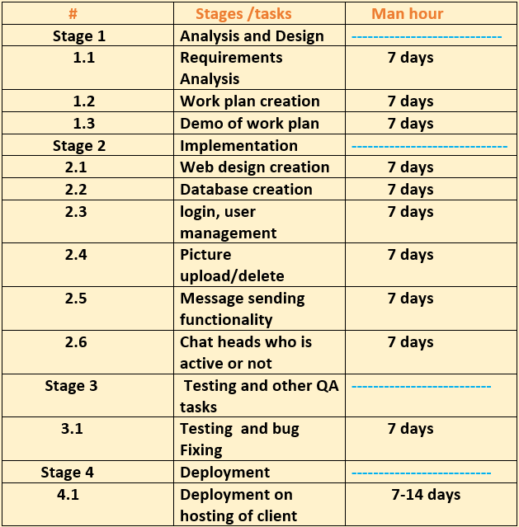

Time Distribution

Slide 16
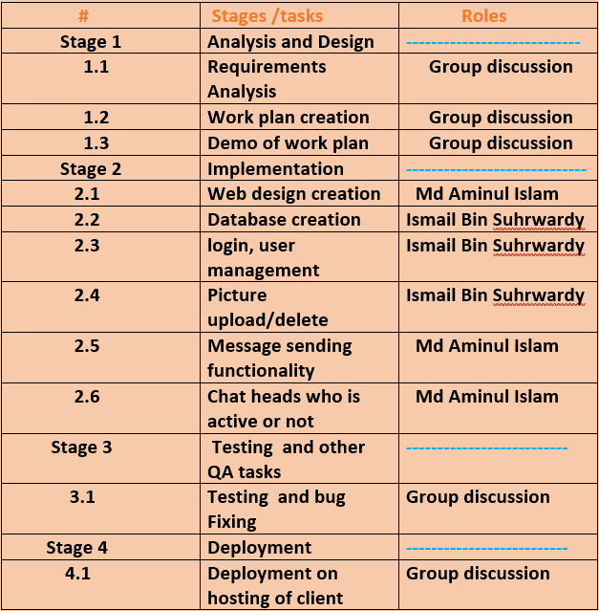

Roles & Responsibility

Slide 17
Conclusion
This is a messaging app with a focus on speed and security. The user would be able to chat, see who is online or offline. He has the power to delete his own chat if necessary.
The app, which is free to join, can be used to communicate with your friends. This is a cloud-based messenger . As a result, you can access your messages from several devices at once.

